Slide 1


Data Mining Project
‘Stack-Exchange’
Nir Barazida and Inbar Shirizly
02.08.2020
Tech Mentor: Yoni Mayzel
Notes:
Nir
Stack EX!

Slide 2


Agenda
Goals
Work-flow
Challenges
Data Base
Insights
Upcoming features
Notes:
Nir
Read bolet points

Slide 3
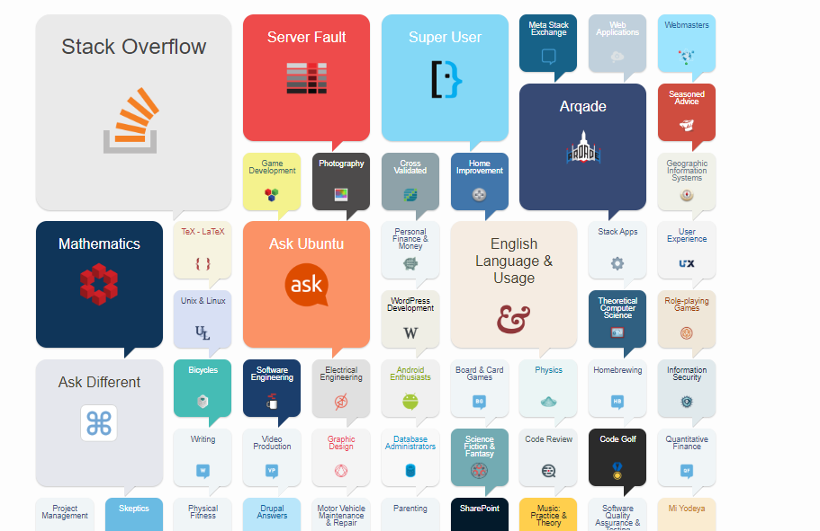

Project topic
Project Topic
Notes:
Nir
1 לנתח משהו משמעותי – יתן ערך מוסף לאתר או למשתמשים בו
2 בחרנו בסטאק אובר פלאו -> מתמקדים ביוזרים -> מה שבחרנו לנתח
3 עשינו קצת מחקר וגילינו שזה חלק מקבוצה יותר גדולה של אתרים

Slide 4
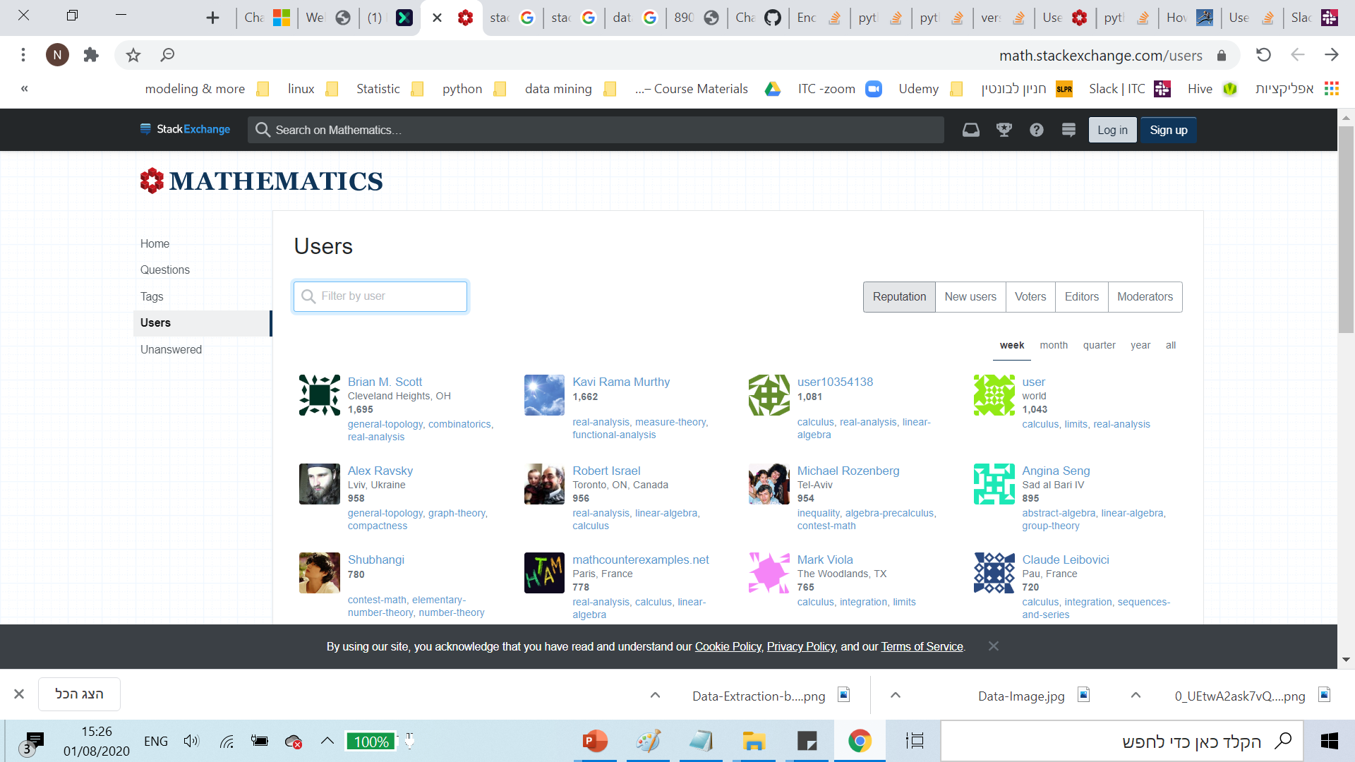
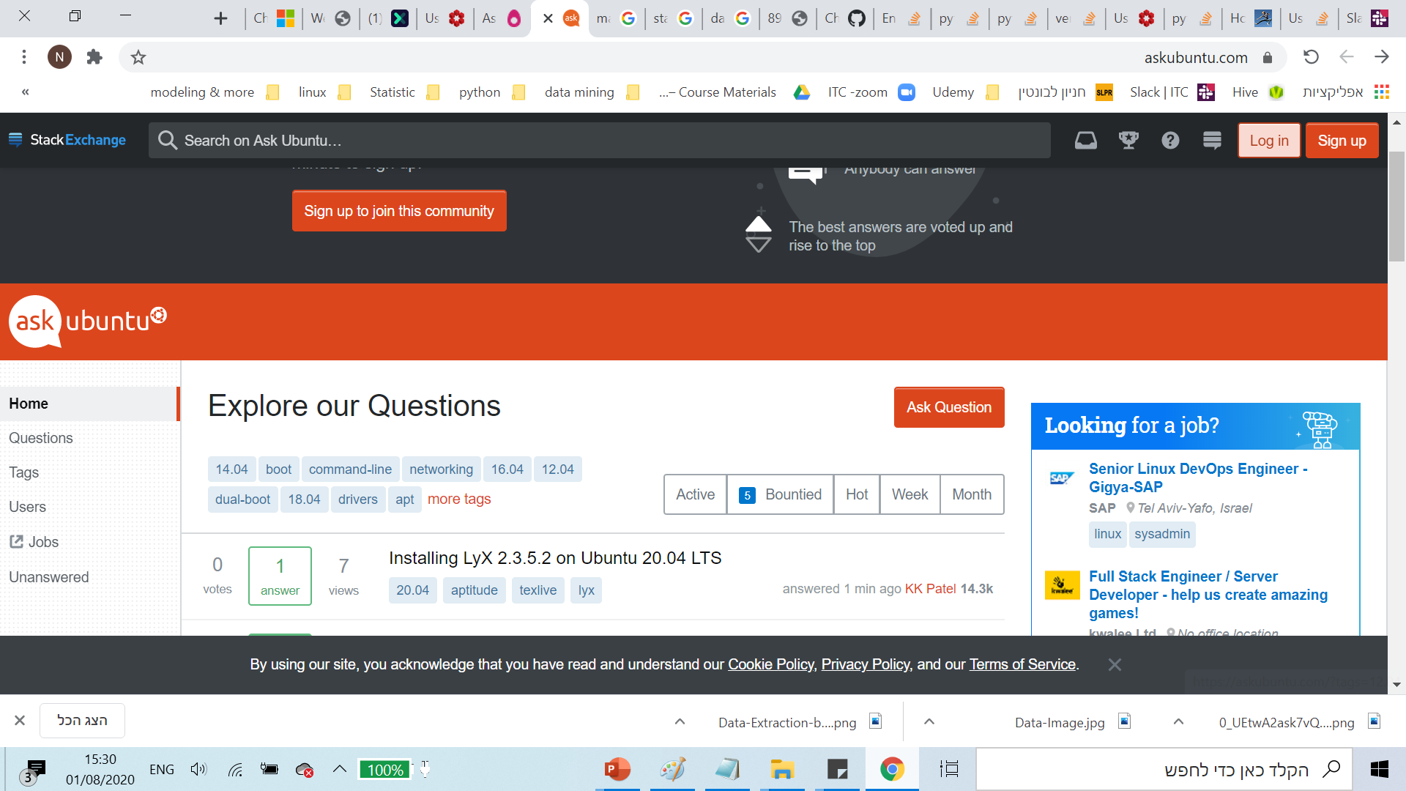

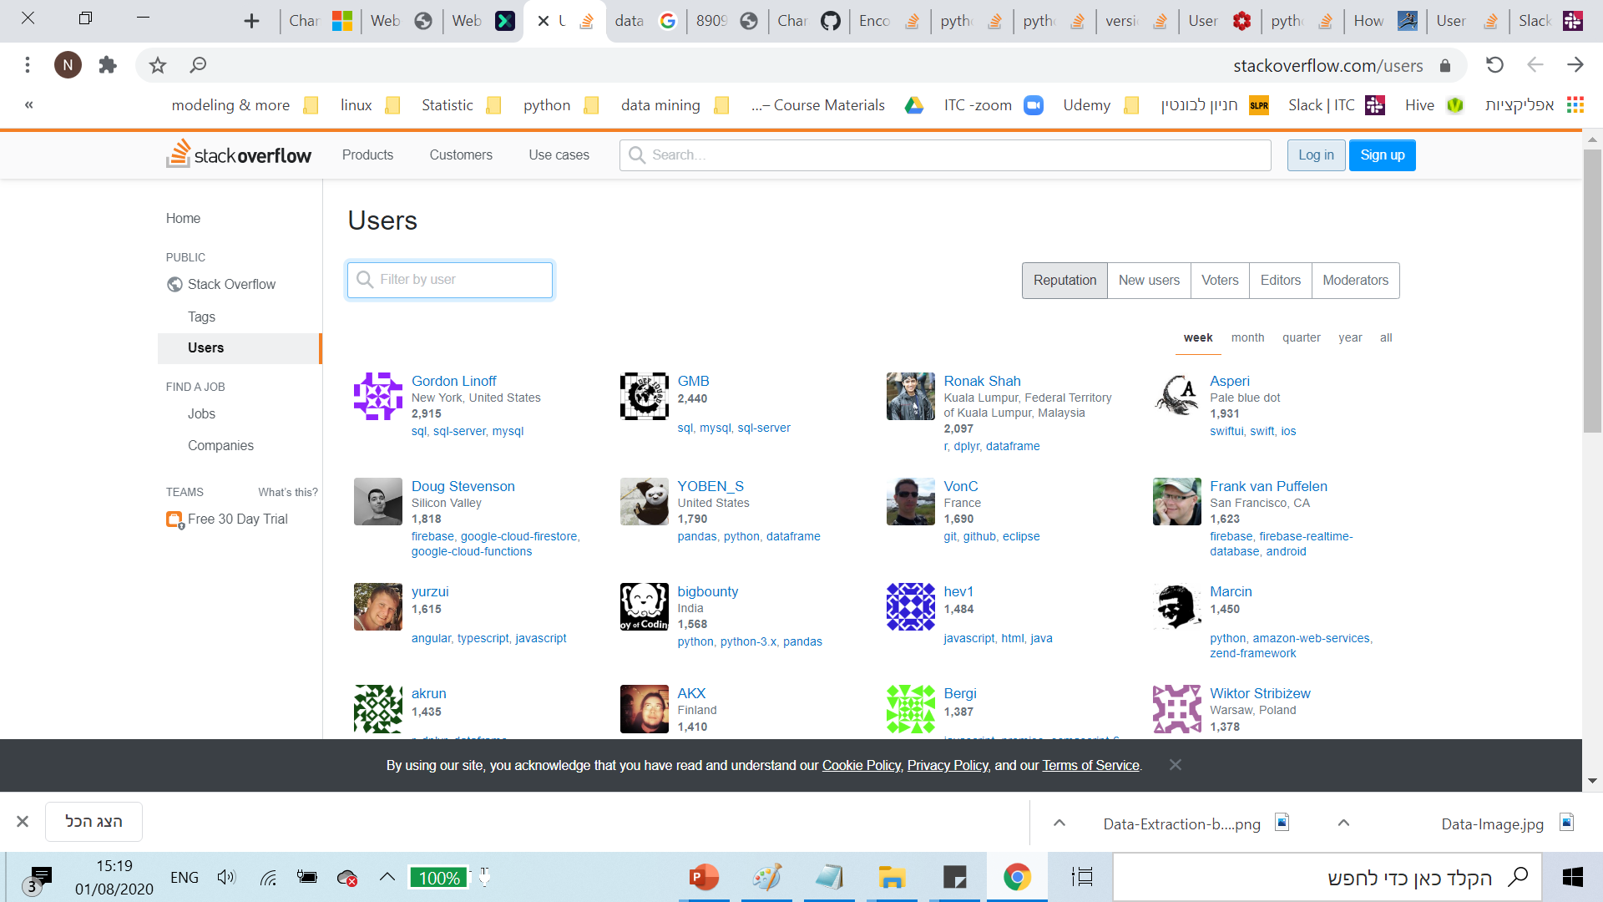
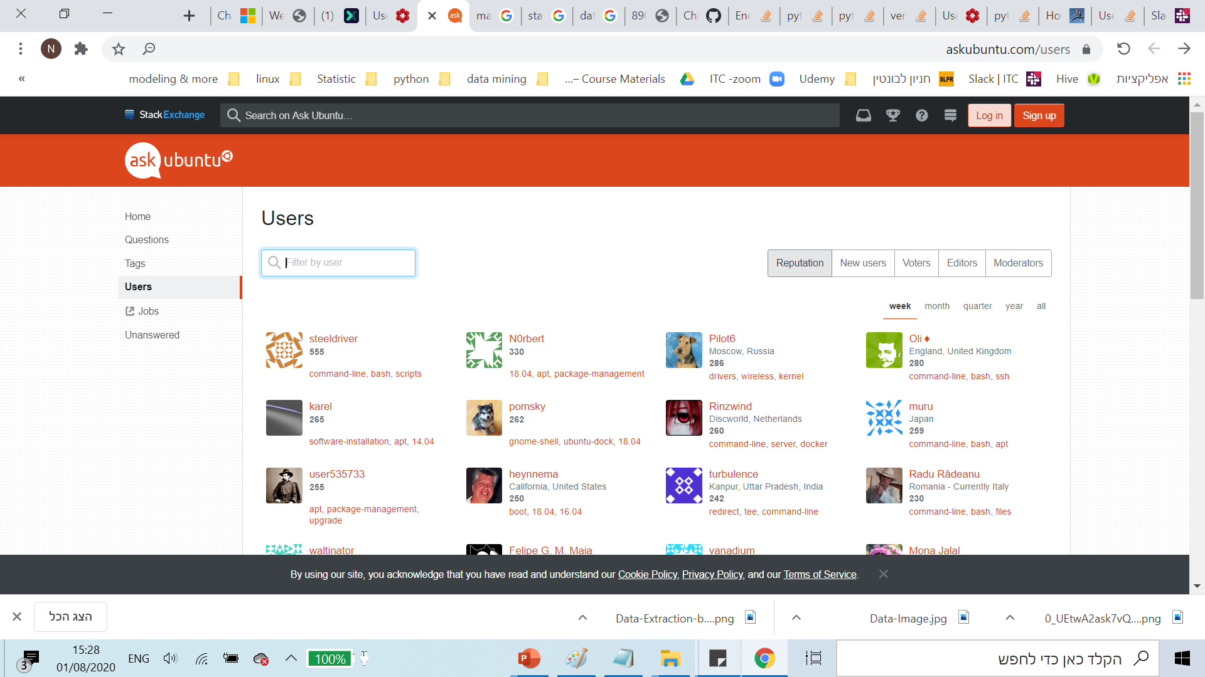
Project Topic
Notes:
Nir
בדקנו את הhtml של כל האתרים וגילינו שהוא זהה – ניתן לנתח את כולם עם אותו קוד !! BAM

Slide 5
Goals
Goals
Project goal: Present meaningful insights
Analysis goals:
Analysis of user's contribution to website community based on geographic location.
Analysis of user statistics over time.
Analysis of trends by countries
Programing goals:
Code efficiency – scrap as much users as fast as possible.
Auto-scrapping.
Notes:
Nir

Slide 6
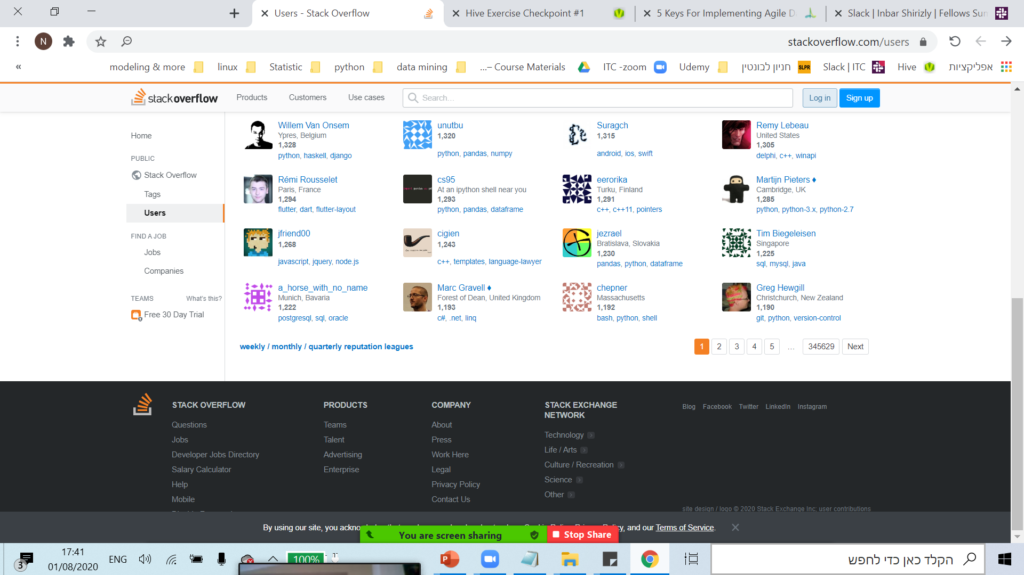
Work-flow
Work-flow
Scraping class:
Website
UserAnalysis
Notes:
inbar

Slide 7
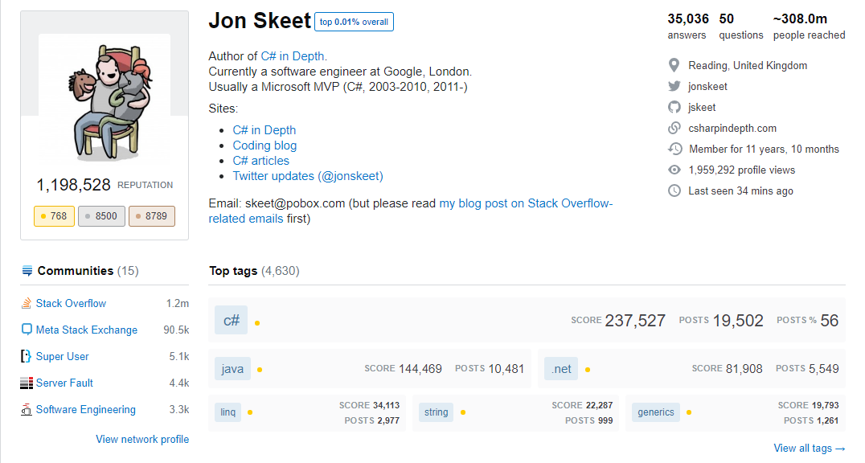
Work-flow
Work-flow
Scraping class:
Website
UserAnalysis
UserScraper
Notes:
inbar

Slide 8
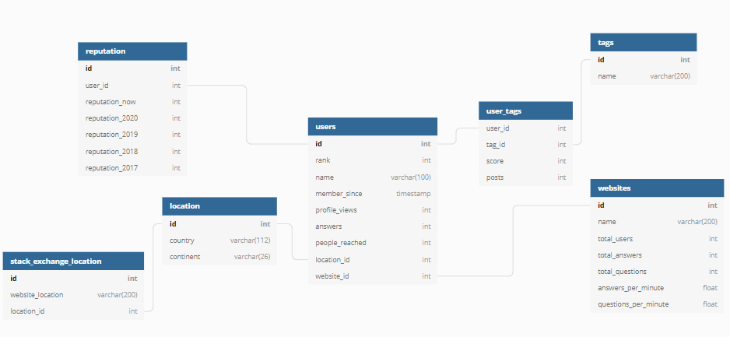
Work-flow
Work-flow
Scraping class:
Website
UserAnalysis
UserScraper
UserToDB
Notes:
inbar

Slide 9
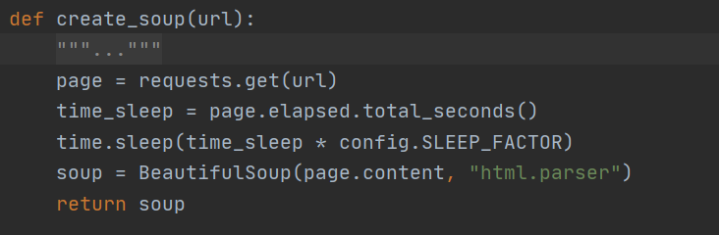
Challenges
Challenges
Request blockage
Notes:
– OOP , usage of package (__init__.py file)

Slide 10
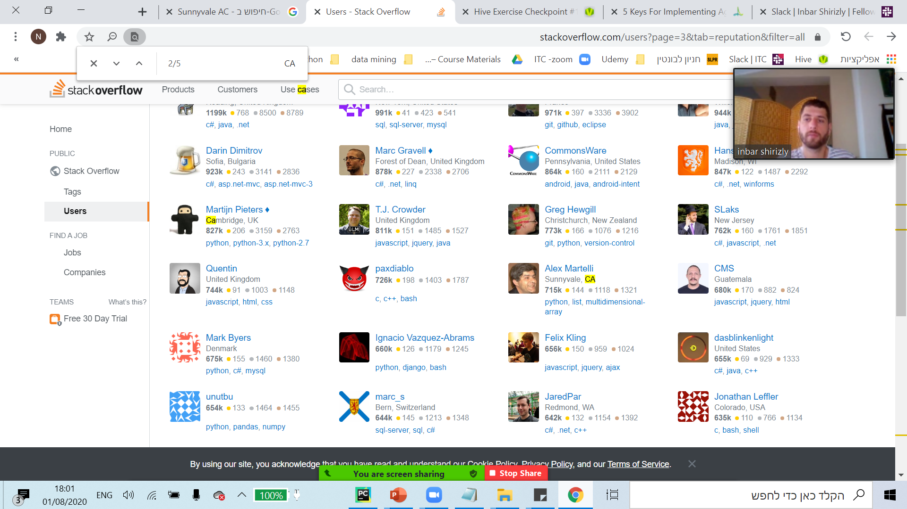
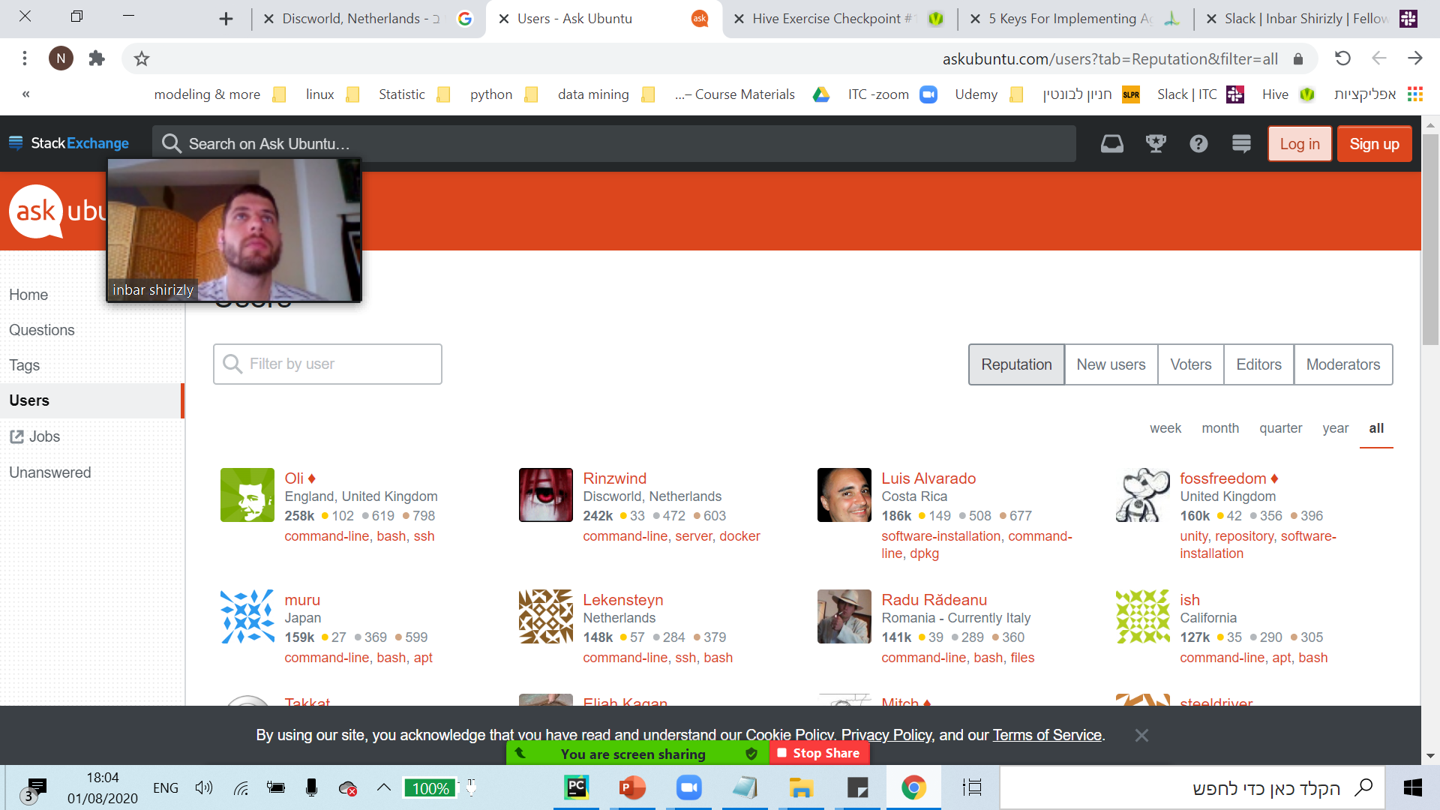
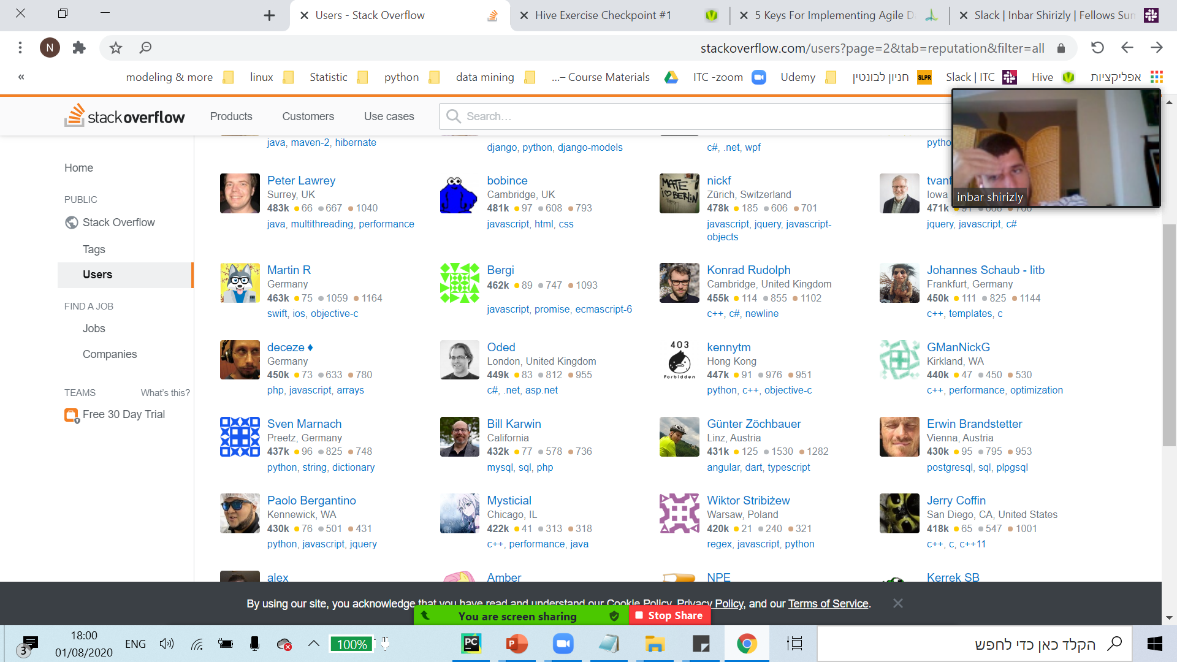
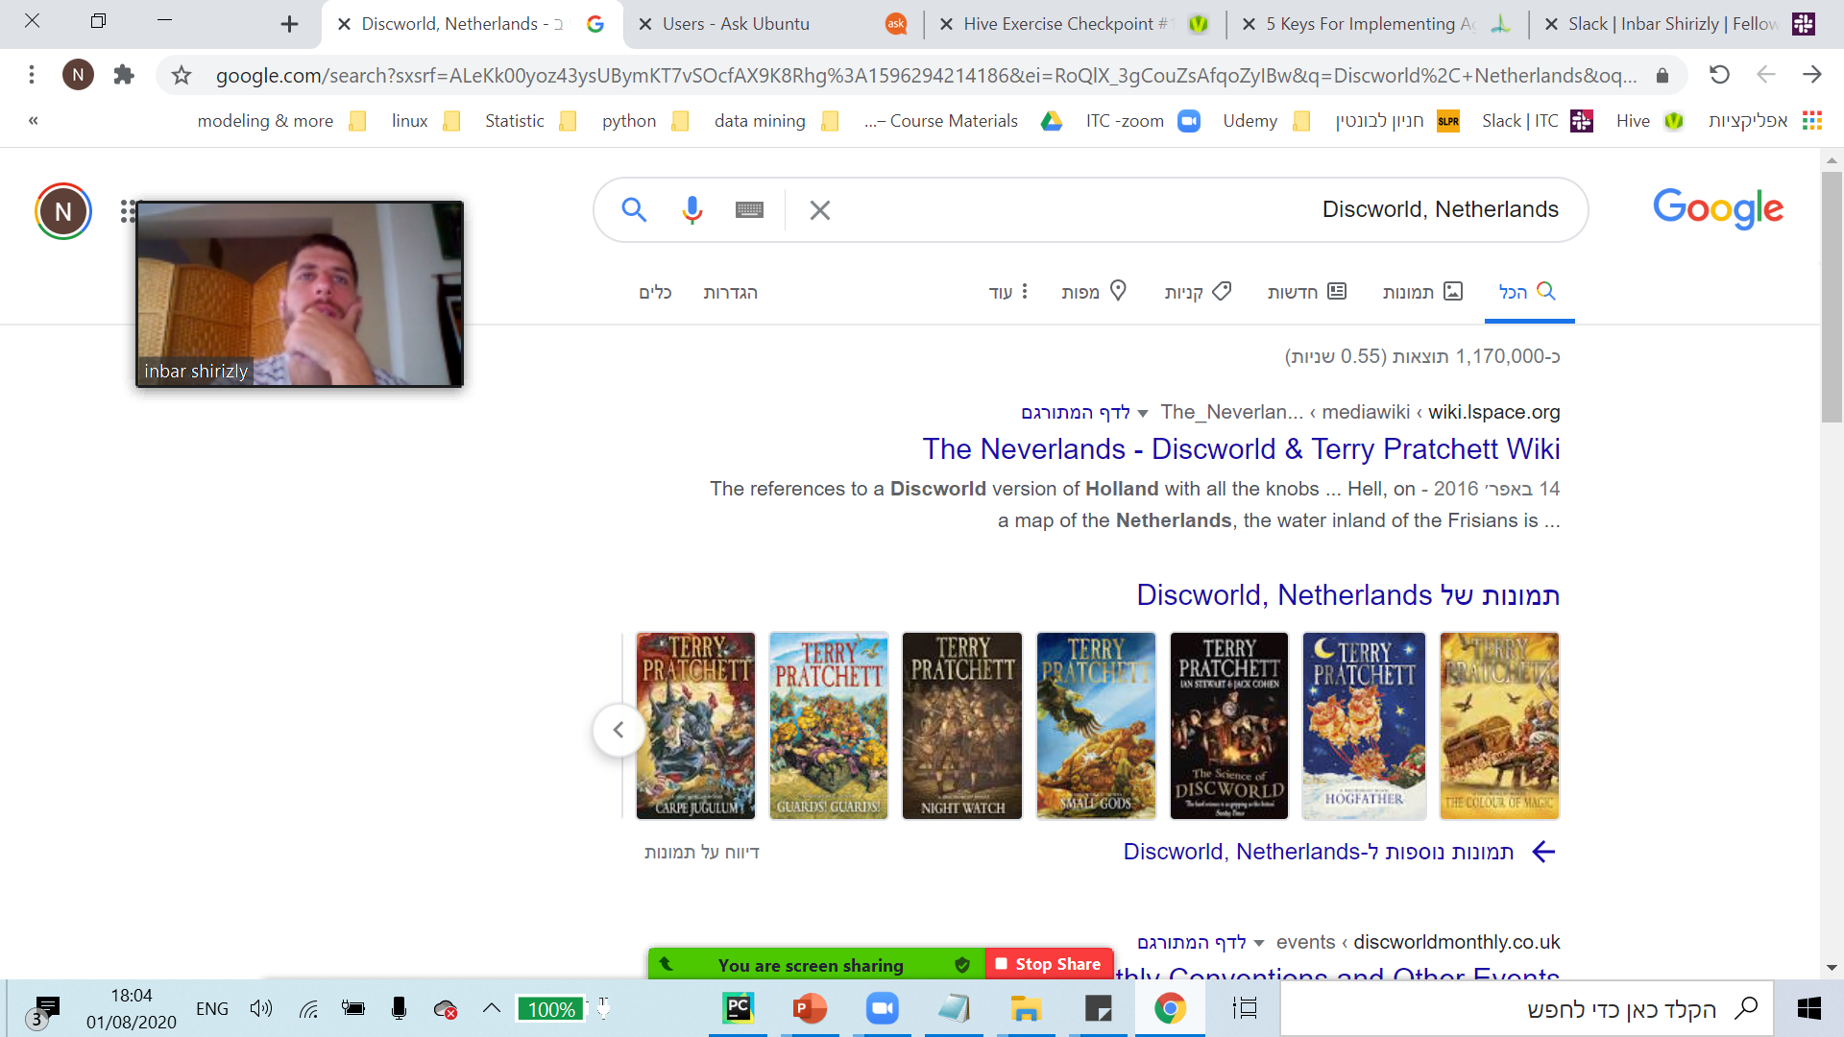
Challenges
Challenges
Location:
Generalize user location.
Shorten scraping time.
Notes:
Nir

Slide 11
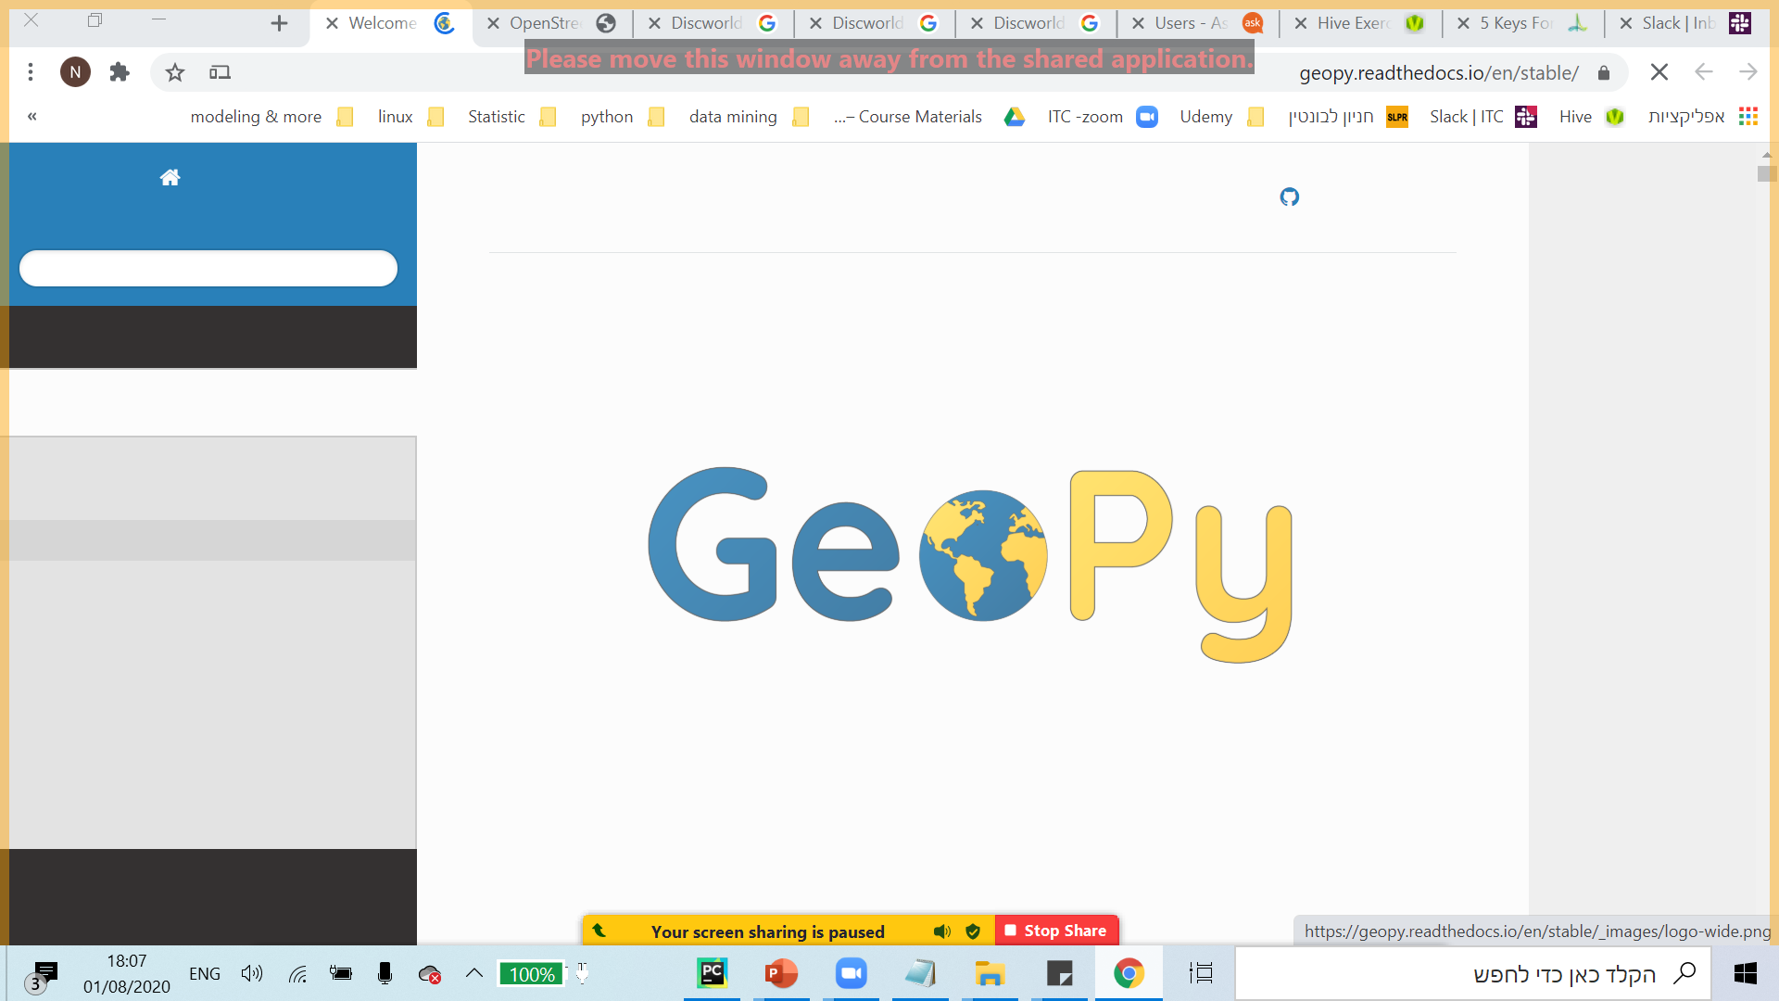
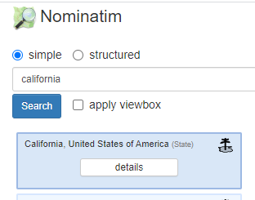
Challenges
Challenges
Location:
Generalize user location.
Shorten scraping time.
Notes:
Nir

Slide 12


Challenges
Challenges
Using ORM – object relational mapping
Notes:
Nir

Slide 13
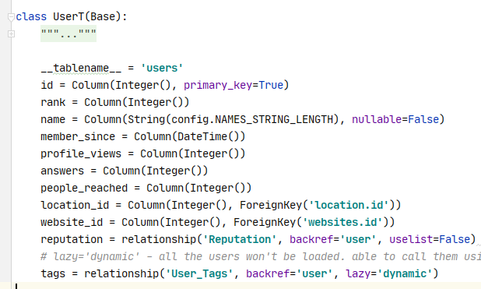
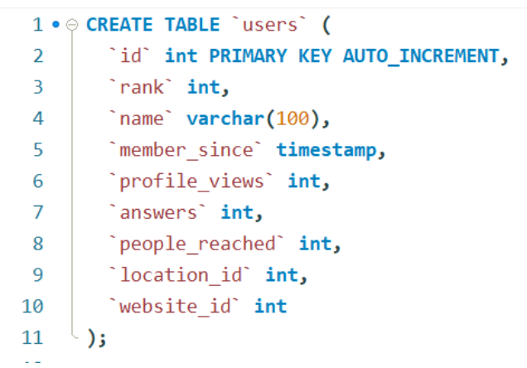
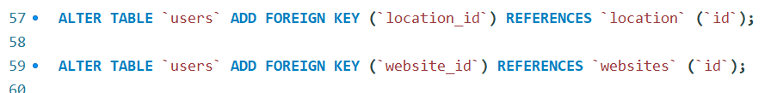
Challenges
Challenges
Using ORM – object relational mapping
Notes:
Nir

Slide 14

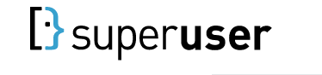
Challenges
Challenges
Multi-processing
Start
Start
Notes:
inbar

Slide 15
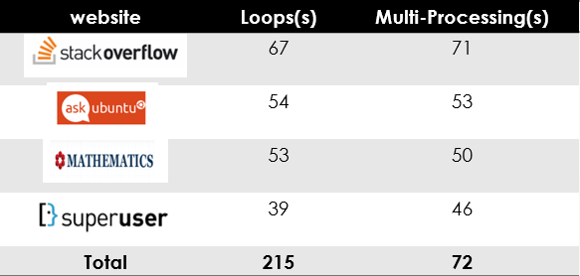

Challenges
Challenges
Multi-processing
Scraping 10 users from every website
3 times faster !!!
Notes:
inbar

Slide 16
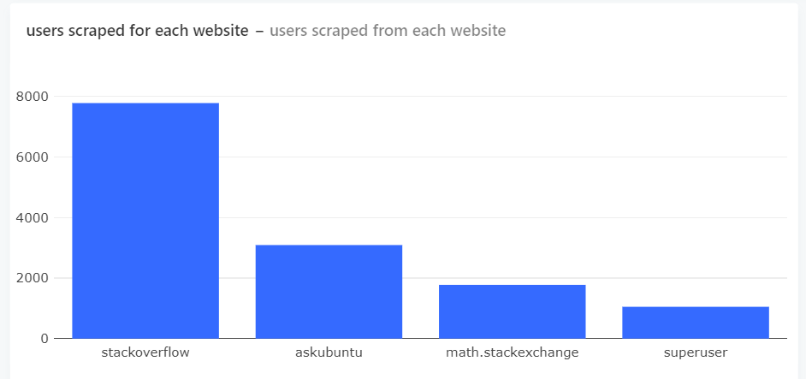
Insights
Insights
Disclaimer – the insights are relevant to specific amount of top users
website | Total users
 | ~13M
 | ~850k
 | ~680k
 | ~920k
Notes:
inbar

Slide 17

Great start, but..
Great start, but..
Test file and improve code structure
Wishful thinking:
Multiple machines run the program on the same database
Deal with duplicate when using multi-processing / multiple machines run the program
Deal with missing user:
During the running code / between session the users update the rank – chance to scrap the same user twice and missing user the climbed up
Notes:
inbar

Slide 18

Upcoming features
Notes:
inbar

